Slide 1
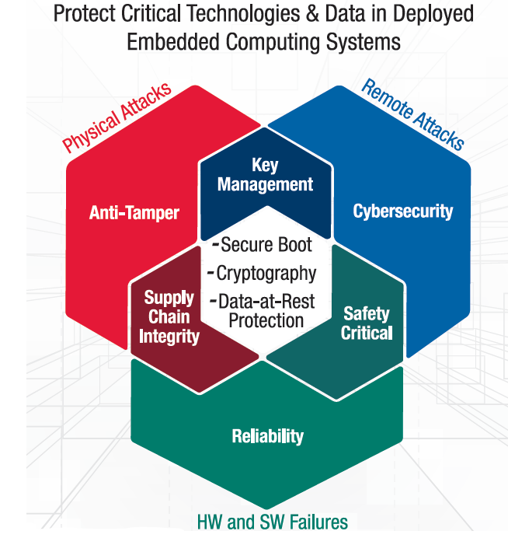
Agenda
Security HC
Trusted Computing SIG
Security Model TG
AP-TEE TG
Some topics to consider:
Secure Boot/ Root-of-Trust?
OpenTitan?
Welcoming post-quantum algorithms for secure boot (like Intel UEFI trends)
Key mgmt./ provisioning/ zero-touch provisioning
Anti-tamper?
Supply chain integrity?
Safety? è maybe participate in Safety SIG
Reliability è maybe participate in RAS SIG if exists
Software/ Compilers?
TCB optimization?
Certifications?
Anything else?
Trusted Computing: A layered approach to Security

Slide 2
Agenda (2)
Special request from Vedvyas Shanbhogue (SoC Infra HC Chair)
Provide SoC Infrastructure requirements from a confidential compute use case (a 1-page document), some examples below
RoT
PUF/ QTRNG/ OTP?
Memory controller/ encryption engine
MMU, MPU, IOMMU, IOMPU, extensions
CPU ISA extensions
Etc.
AP-TEE TG

